Slide 1
Insurance Premium Risk & Loss
Analysis Tools Used: SQL | Excel Dashboard
Dataset Size: 500 Motor Insurance Customers
Created By: Moagi Mashiakgomo

Slide 2
Business Problem
Insurance companies must ensure that premiums collected adequately compensate for claims risk exposure. Mispricing high-risk segments can result in deteriorating loss ratios and long-term profitability issues.
This project evaluates:
Premium distribution across risk tiers
Claims exposure by risk level
Overall portfolio loss ratio
Revenue concentration risk

Slide 3
Portfolio Overview
Risk Level | Customers | Total Premium | Total Claims | Loss Ratio
High | 90 | P1,871,193 | 96 | 0.000051
Medium | 217 | P4,565,455 | 209 | 0.000046
Low | 193 | P4,029,363 | 183 | 0.000045
Total Customers: 500
Total Annual Premiums: $10,466,011
Total Claims: 488
Overall Loss Ratio: 0.0047
The Portfolio demonstrates stable premium inflow with relatively low claims frequency compared to total premium volume.

Slide 4
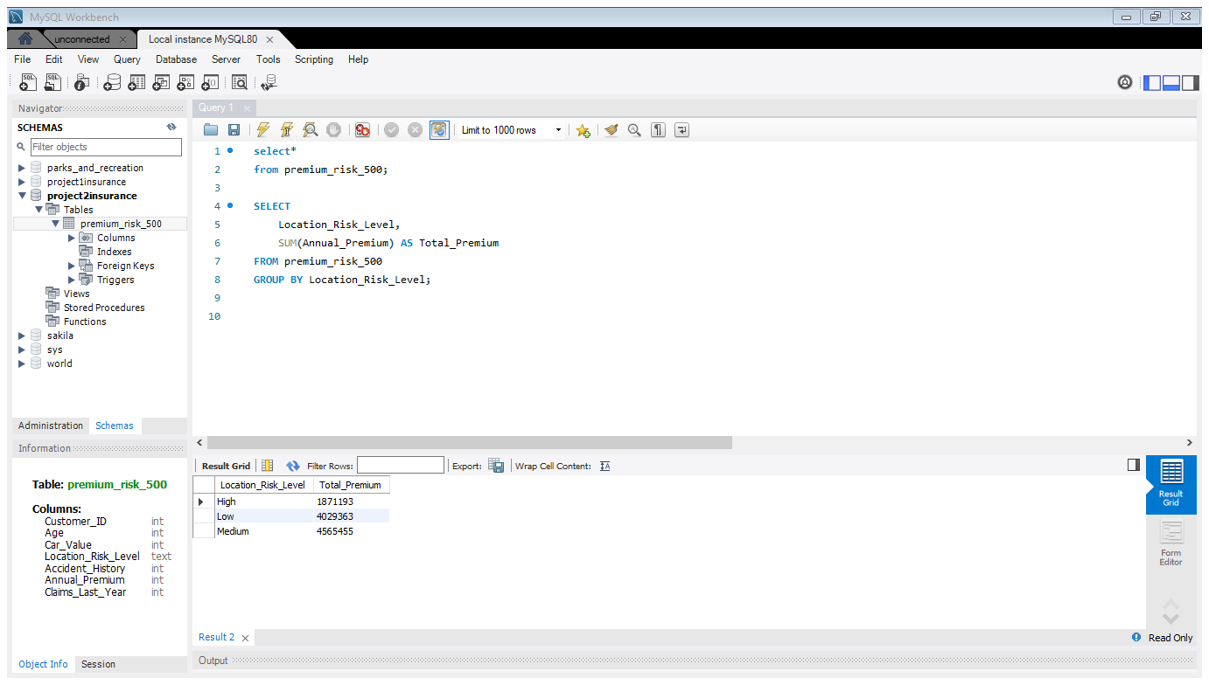
Total Premiums By Risk Level
Assesses Revenue Concentration Across Risk Levels
This shows that our revenue is dominated by the medium risk level followed closely by the low risk
SQL Query Used:

Slide 5
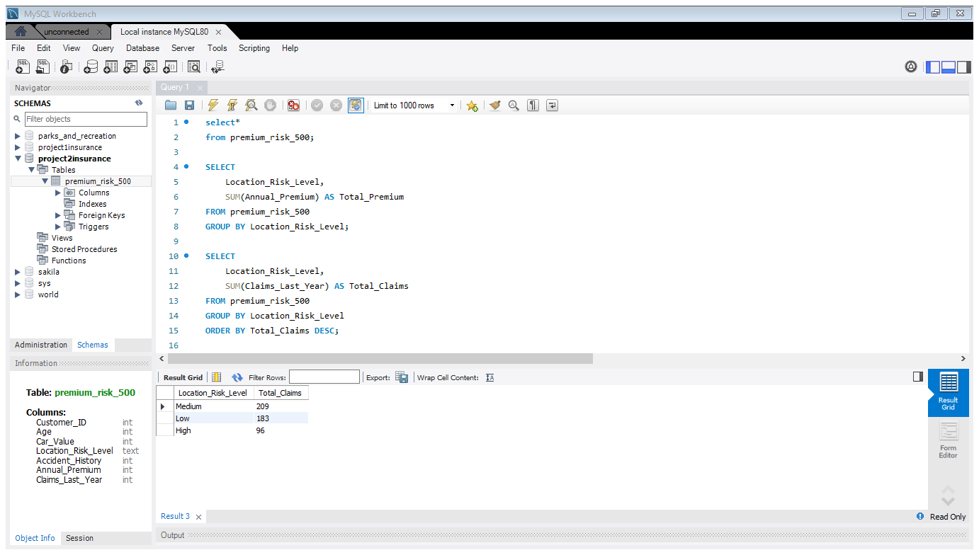
Total Claims
Evaluate Which Risk Level Contributes To The Most Claims
SQL Code Used:

Slide 6
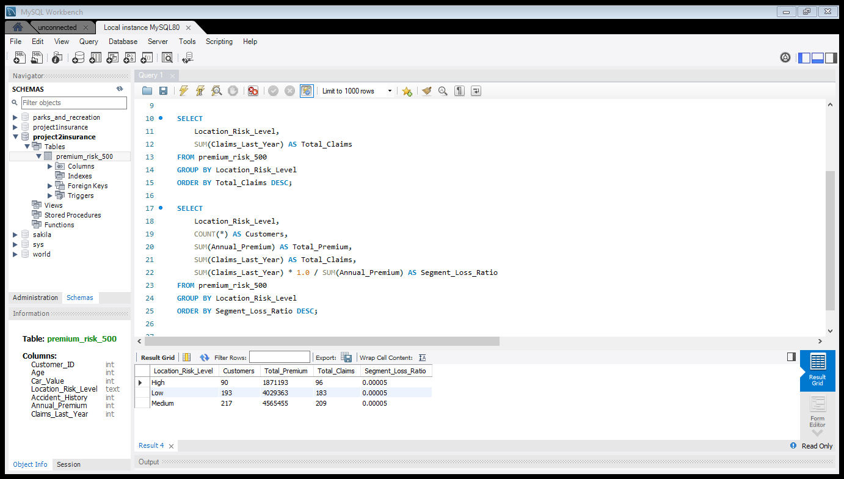
Risk Level Loss Ratio
Determine Loss Ratios For Each Risk Level
SQL Code Ran:

Slide 7
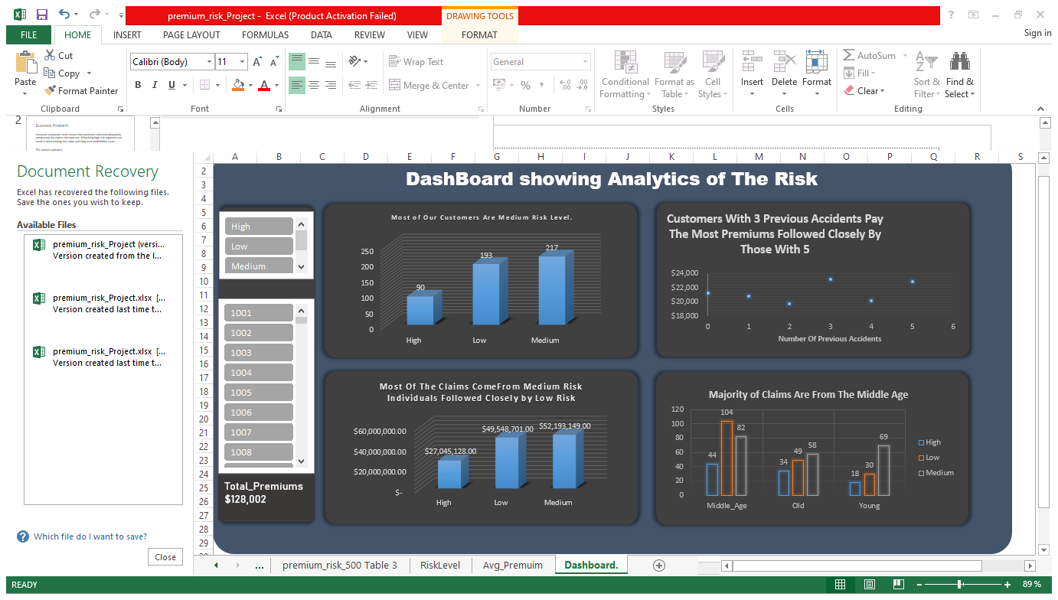
Dashboard Analytics
Medium Risk segment represent 43.4% of customers and 47% of the total claims in the past year
Middle aged customers cover most of the claims 47% with 45% of them belonging to the low risk segment

Slide 8
Business Recommendation
Review Pricing Strategy for High-Risk Segment
Adjust premium multipliers or introduce stricter underwriting criteria.
Enhance Risk-Based Monitoring
Implement automated flags for high accident history customers.
Introduce Risk Incentives
Offer discounts for claim-free years to reduce exposure and encourage safer behavior.
Monitor Segment-Level Loss Ratios Quarterly
Early detection prevents long-term underwriting losses.

